Slide 1

P4XT Transponder Project
Wally Ritchie - WU1Y
Principal Investigator P4XT Open Research Institute

Slide 2
WHY DO THIS?
There is No ready to Fly Payload
Analog Transponders have Serious Shortcomings
Inefficient use of bandwidth
Subject to hijacking
Interference
Satellite Disaster Capability is virtually non-existent
Paper Designs and Demos are Not enough

Slide 3
PROJECT GOALS
SPACE BASED TRANSPONDER
All Digital Design
Fully Verified and Validated Design
Read for Final Adapter for Spaceflight
LOW-COST MODEM
Core of low-cost Earth Station Terminal
Full DVB-S2 Receiver
GPS Derived Reference and station clock
Standalone Operation (no separate PC required)
L-BAND IF Inputs and Outputs
< $ 250 Target Price

Slide 4
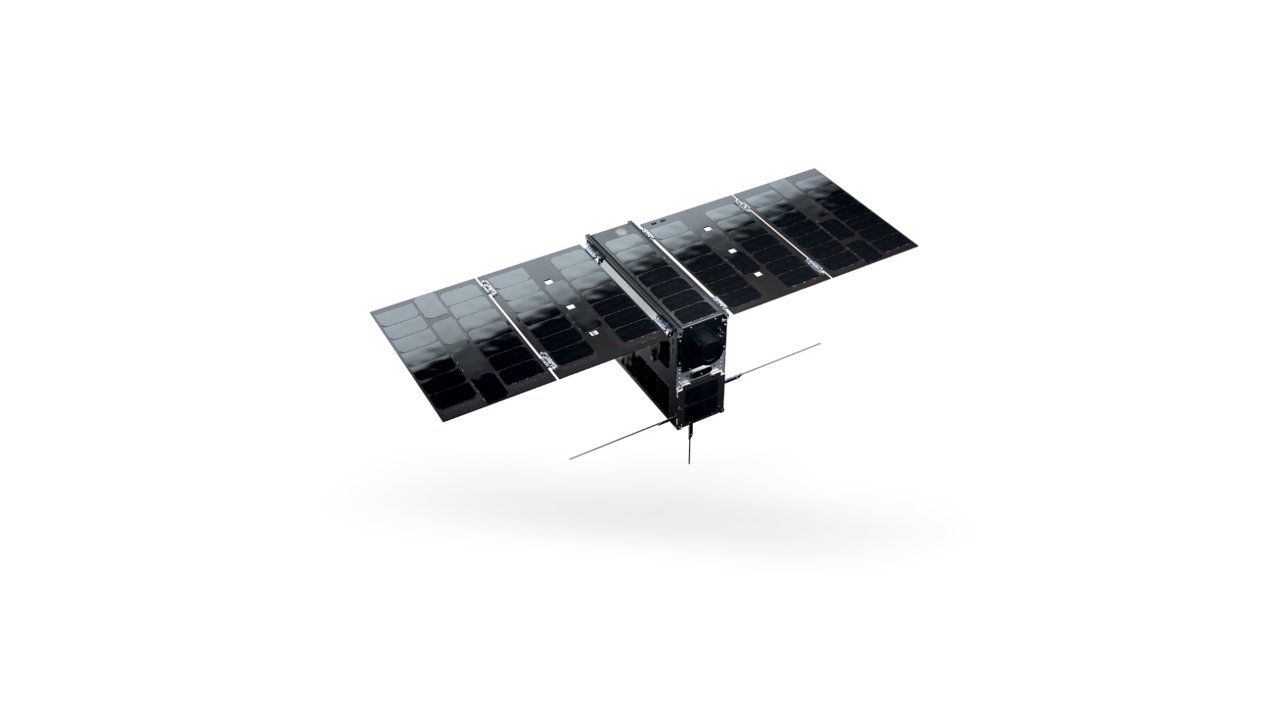

6U CUBESAT

Slide 5
6U Cubesat (100mm x 200mm x 300mm)
Notes:
AAC Cylde Space EPIC 6U

Slide 6
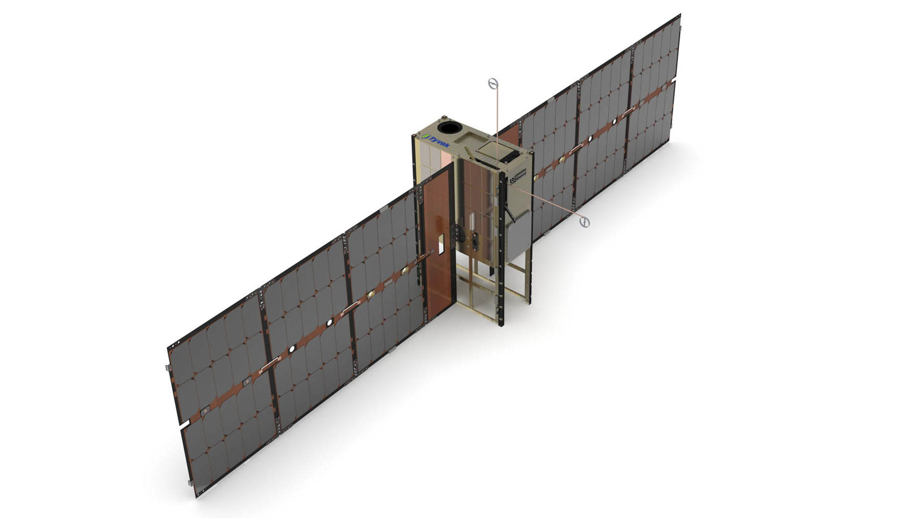
6U 120W Peak Solar Array Power
Notes:
Tyvak TRESTLES 6U

Slide 7
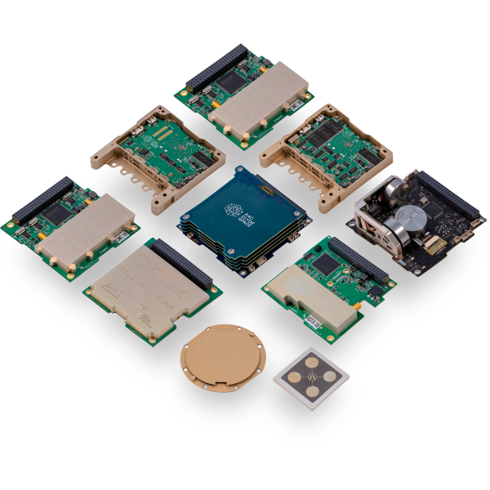
Cubesat Bits

Slide 8
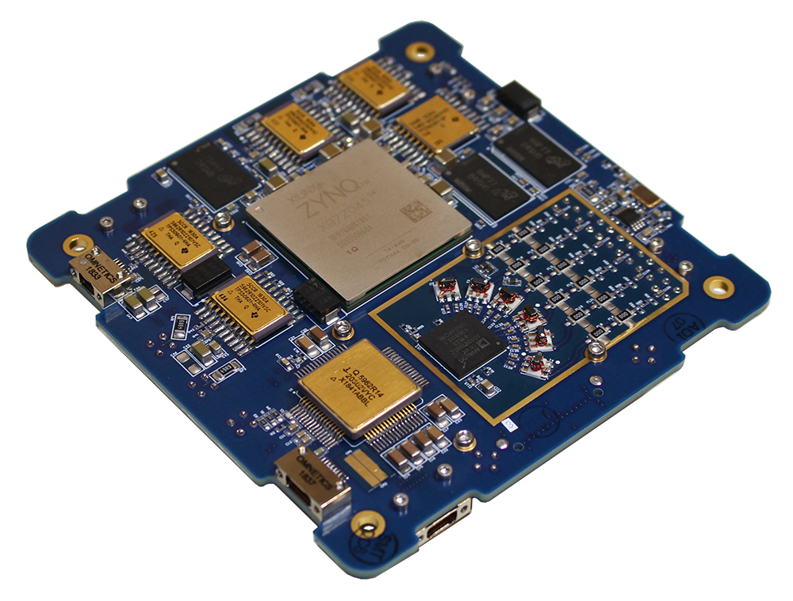
RINCON AstroSDR

Slide 9
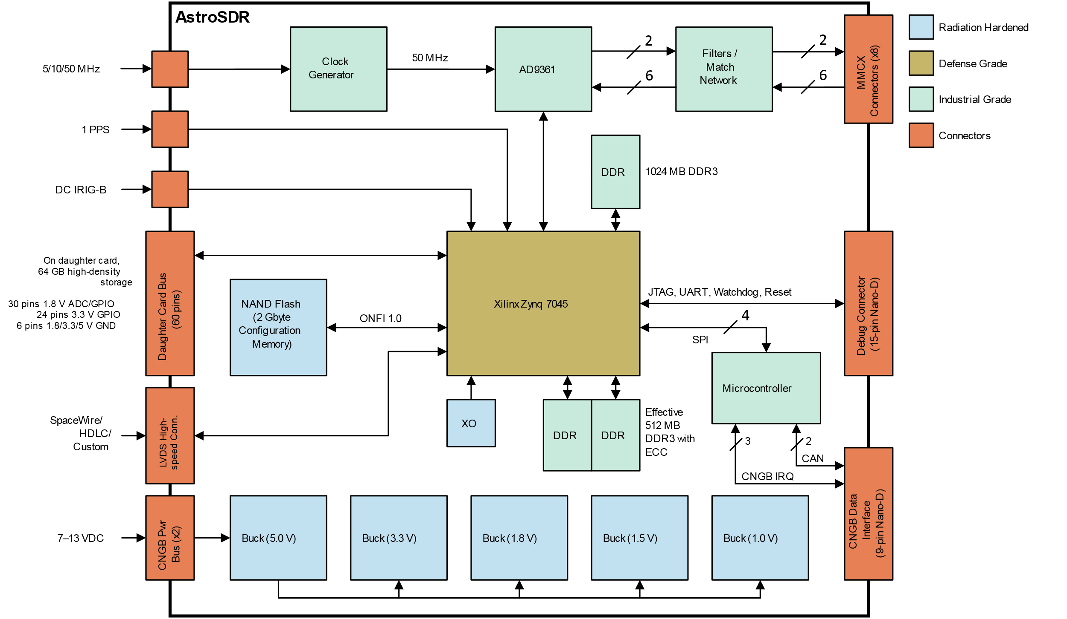
AstroSDR Block Diagram

Slide 10
Why DVB-S2
DVB Standards are International, Free, and very widely used.
DVB-S2 is the 2nd Generation Standard
Generic Stream Encapsulation (GSE) used for the downlink data.
QUASI Error Free (QER)

Slide 11
P4XT Downlink
10.450 (typ) GHz Carrier
Single Downlink
Saturated Power Amplifier (maximize DC efficiency)
Up to 8+ Megasymbols per Second
DVB-S2 QPSK Modulation
ALL Stations synchronize to the downlink
Stations Decode streams they want (including all)

Slide 12
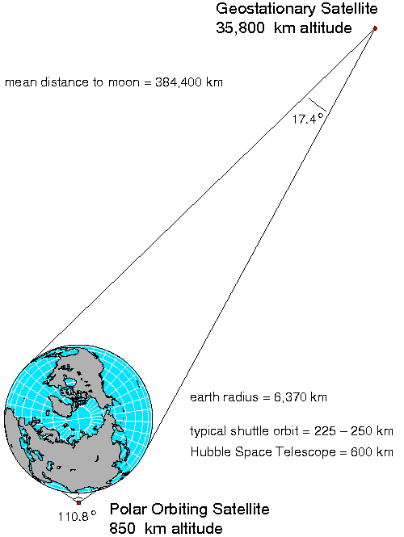
GEOMETRY
Notes:
Geometry.

Slide 13
DVB-S2 Features
Continuous Transmission of frames at symbol rate.
Modulation and Coding (MODCOD) can vary with each frame.
Very Powerful Forward Error Correction (FEC)
Low Density Parity Check (LDPC) codes are nearly ideal. Amateur radio has access to open source implementations.

Slide 14
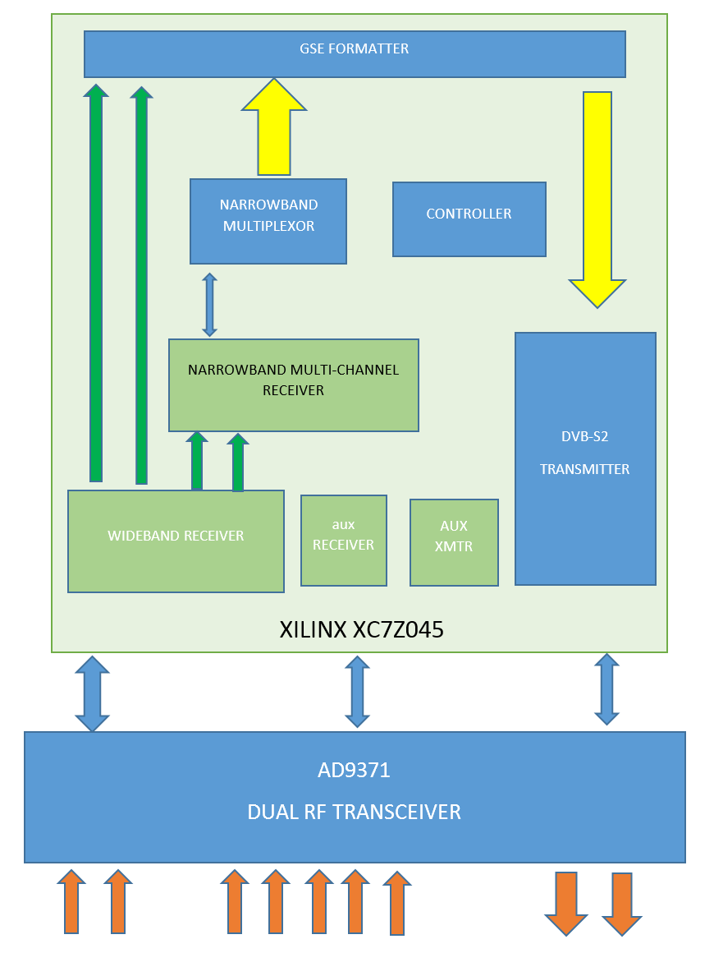

Slide 15
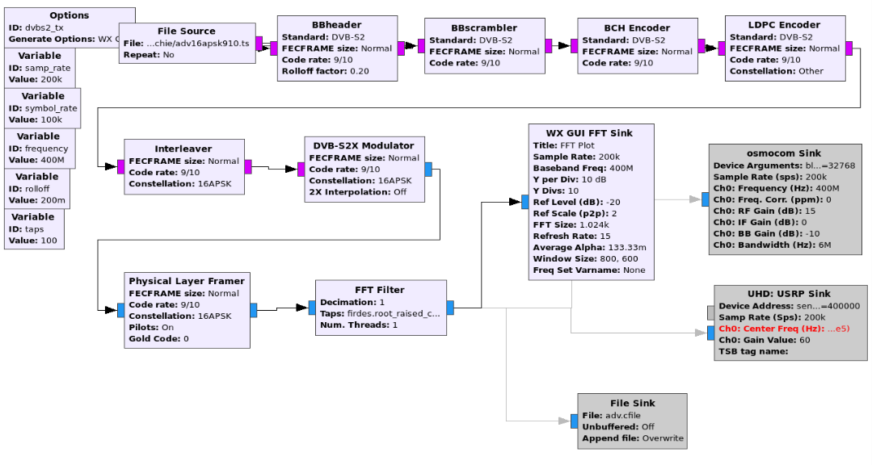
GR DVB-S2 Transmitter

Slide 16
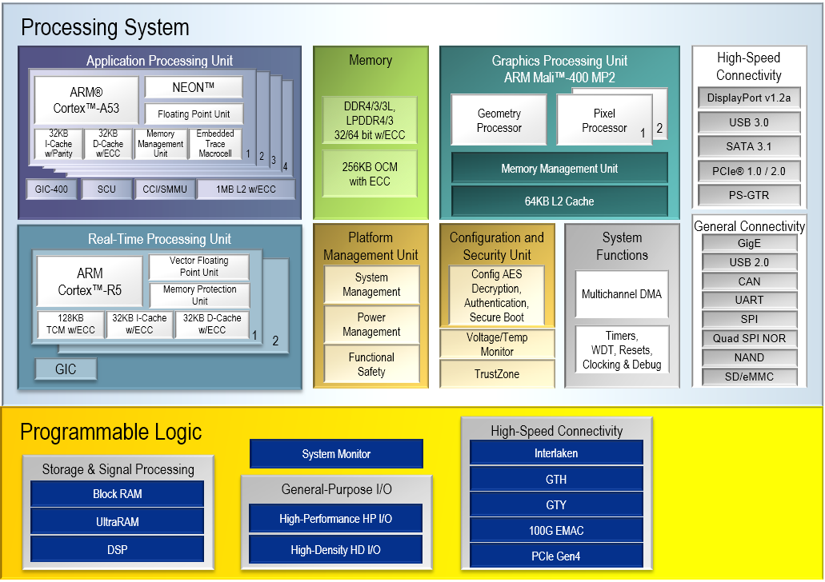

Slide 17
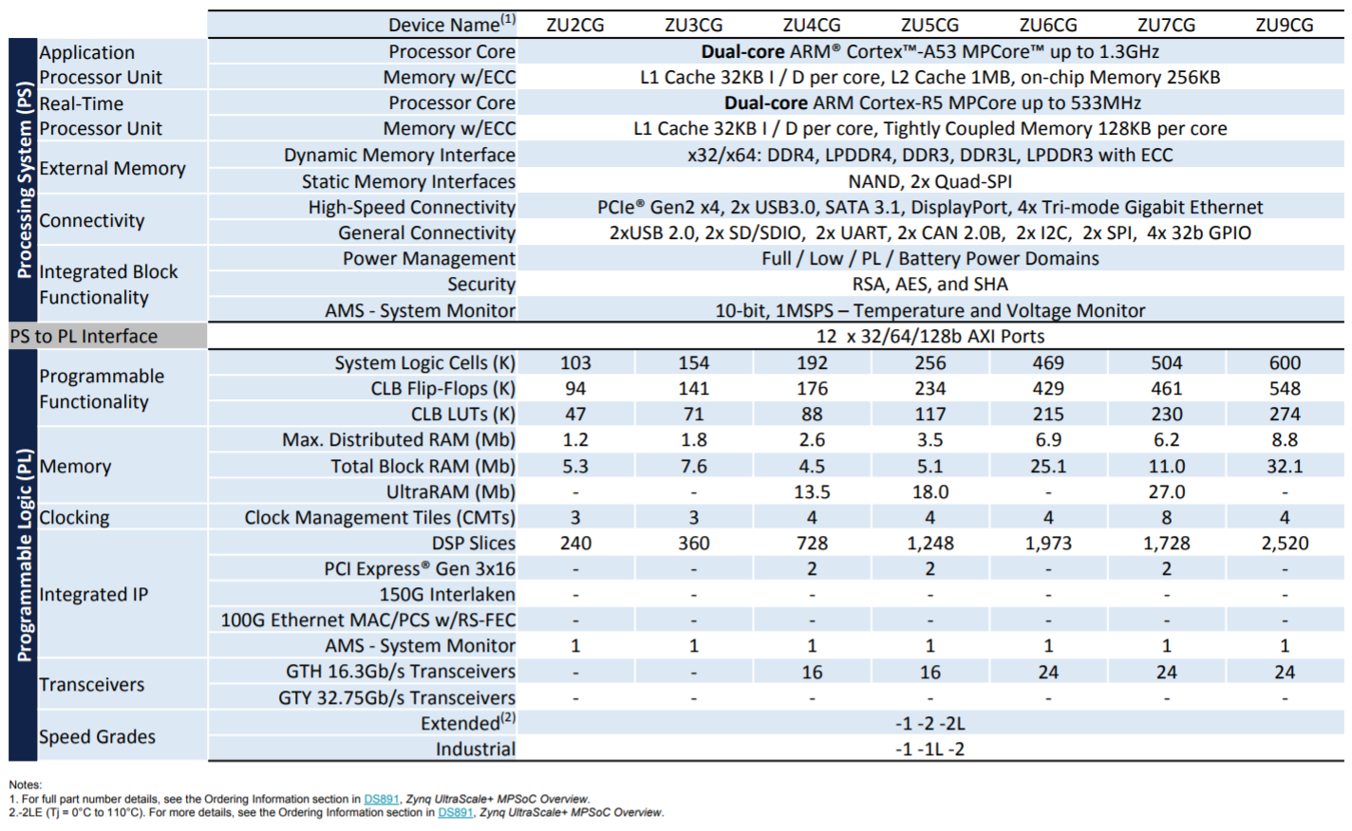

Slide 18
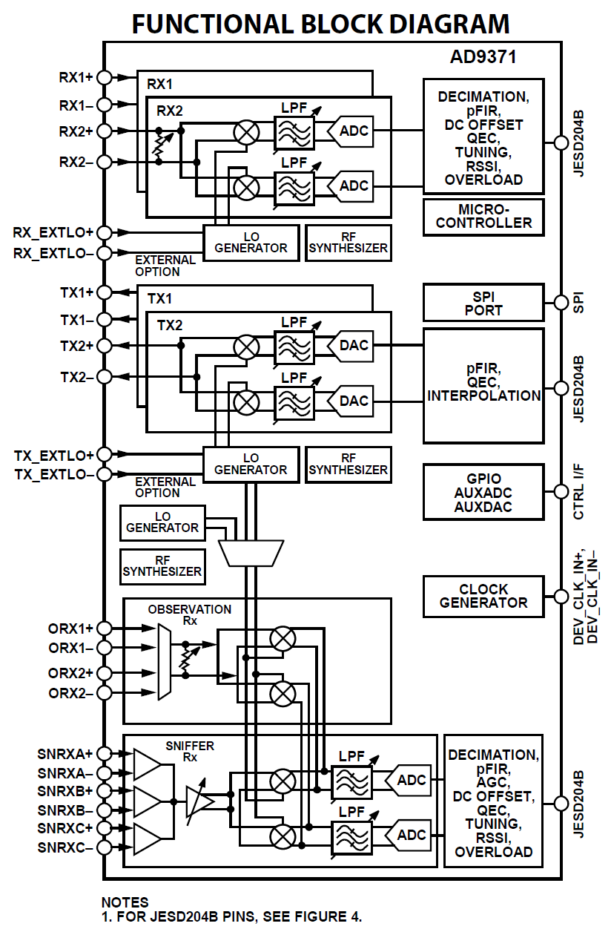

Slide 19
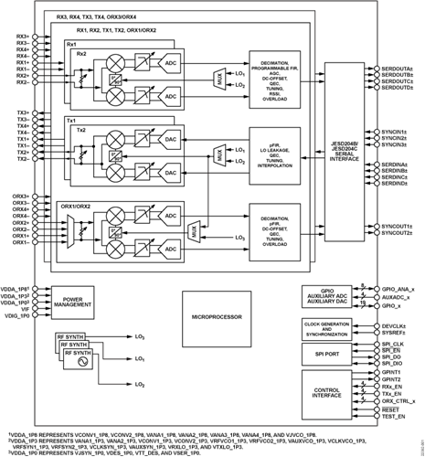

Slide 20
Notes:
The US Military already has a constellation of operational COMM satellites called MUOS. Mobile User Objective System.
The three operational satellites provide global coverage (with a 4th on orbit spare).
Four ground stations or Radio Access Facilities (RAF) each have 2 satellites in view. Each satellite can see two RAF’s.

Slide 21
Notes:
MUOS Terminals operate in UHF for both uplink and downlink.
RAFs Operate in Ka band.
Two hops are always required.

Slide 22
2.4 GHz
10.5 GHz
Notes:
Phase 4A may be able to be used in a ground repeater mode. Conceptually similar to MUOS.
The narrow band uplinks are received by a central Earth Station, Multiplexed into a DVB-S2 carrier, which is uplinked.
All small stations transmit on 2.4 and receive on 10.5 GHz

Slide 23
Repeater Mode Advantages
Only DVB-S2 Receiver Required. (No need for existing transceiver and transverter)
Simple Digital Transmitter on 2.4GHz uplink, 2W
Digital Voice
Expensive Equipment only at Central Station
Coexistence with Analog Modes

Slide 24
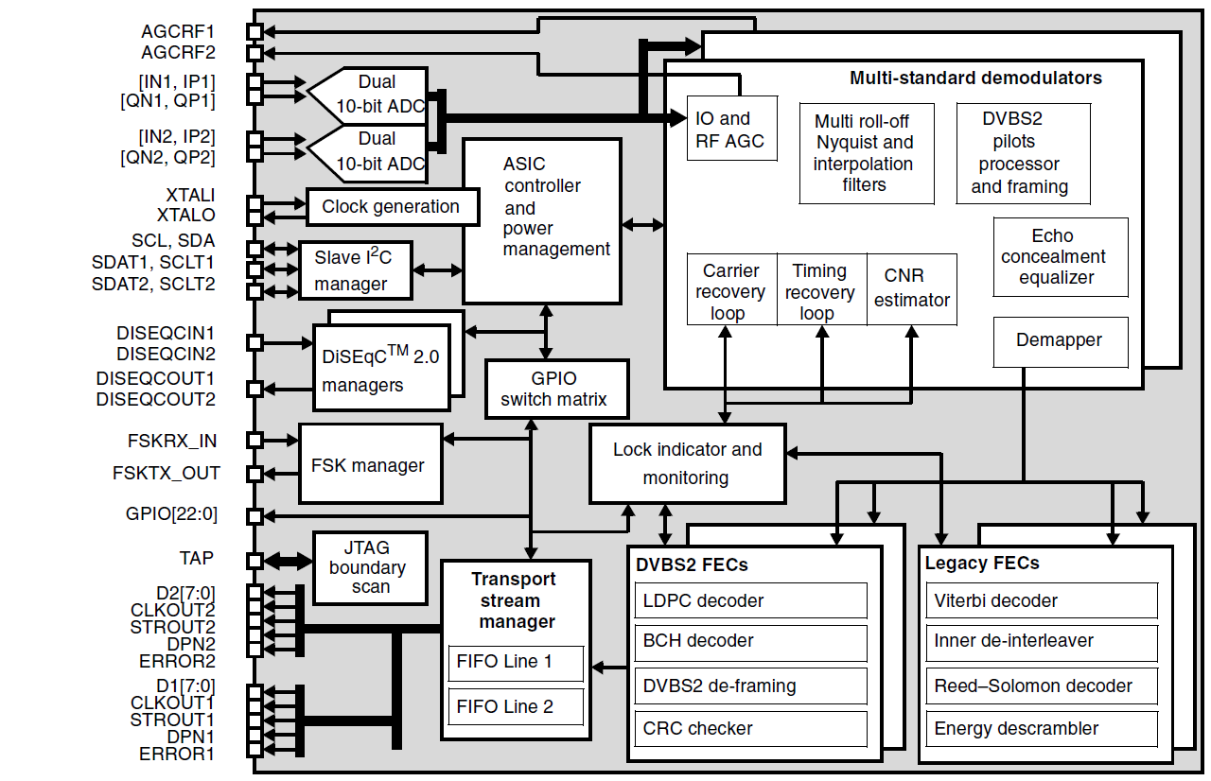
DVB-S2 Demodulator

Slide 25
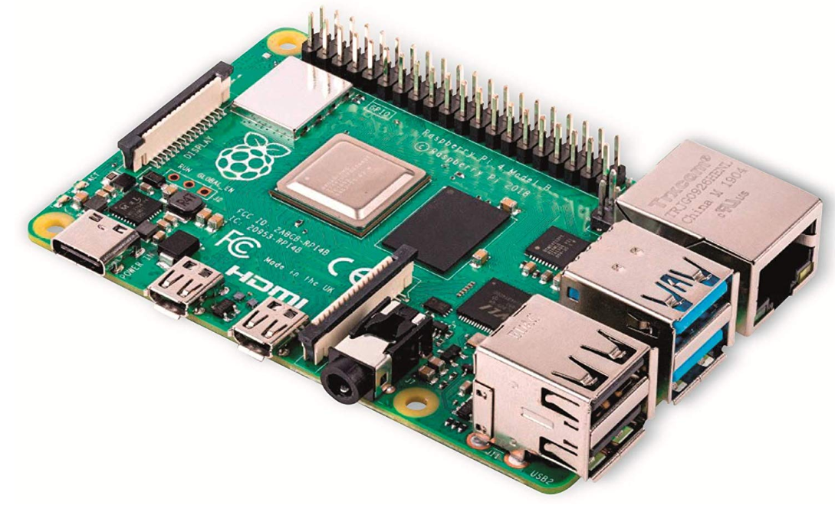
Raspberry Pi-4B

Slide 26
Get Involved
Phase 4 Space
https://phase4space.github.io/
Phase 4 Space
Open to everyone worldwide
Active daily through collaboration tools (Slack, email list, github repository)
Focus on Satellite + Terrestrial Microwave
https://phase4ground.github.io/

Slide 27
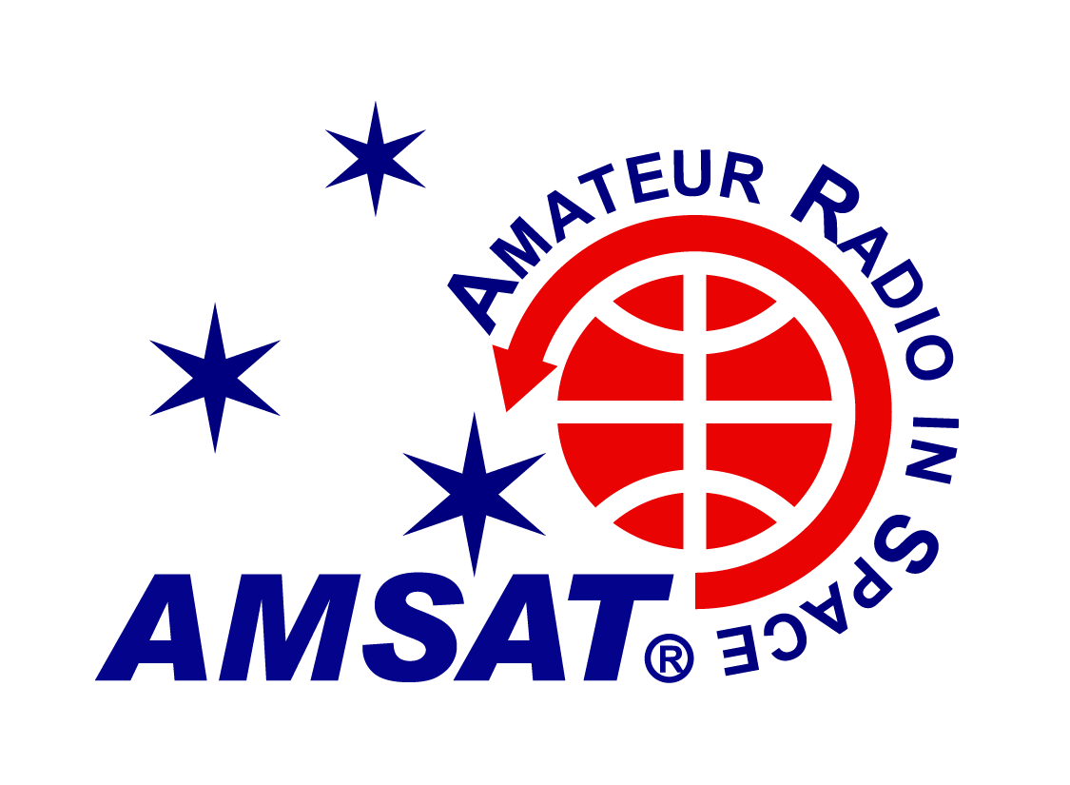
More Information:
https://www.amsat.org
https://phase4ground.github.io/
https://www.amsat-dl.org/
https://amsat-uk.org/

Slide 28
Questions and Discussion

